Slide 1
3D Game engine Programming
Neil Gannon

Slide 2
Overview
Creating bounding volumes
This week we will use the vertex data contained in our 3D models
Stored in an VertexBuffer
Need to the IndexBuffer
First look at the ModelMeshPart
Examine some simple collision tests
BoundingBox
BoundingSphere
Ray

Slide 3
Model Hierarchy
Model
Each model object in XNA is made up of three parts
Model, Meshes , MeshParts
Each model in XNA has at least one mesh
Depends on what/how you create your models
Each mesh can have multiple MeshParts
A batch of geometry information
A subdivision of the model mesh
Separated by the applied material
Model
ModelMesh
ModelMeshPart

Slide 4

ModelMesh
The key members of the ModelMesh we are interested in are:
Name
MeshParts
The collection of MeshParts that make up the mesh
Set of primitives that share a material
ParentBone
Contains a transformation matrix that describes how the mesh is located relative to any parent meshes in a model.

Slide 5
ModelMeshPart
We don’t typically need to go anywhere near the mesh parts
For some advanced rendering techniques then we do
Binary Spatial Partitions would require this kind of access
A mesh part is nothing special, it’s core components are
A Vertex Buffer
An Index Buffer
An Effect
The same components we have used to draw our simple shapes
ColourTriangle etc.
Just declared the vertex data required
The mesh part holds this kind of data for a 3D model

Slide 6
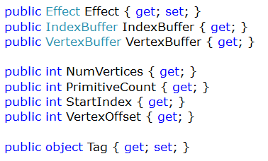
ModelMeshPart
Effect
Allows us to get the current effect applied to the mesh part or to apply a new effect
We change the effect at runtime on a using this property
IndexBuffer
The index buffer for the mesh part
Generated for us
VertexBuffer
Gets the vertex buffer for the mesh part
Again generated for us
NumVertices
The number of vertices contained in the mesh part

Slide 7
ModelMeshPart
PrimitveCount
The number of primitves to render when drawing the mesh part
Inidices / 3
StartIndex
The element in the index array to start from
VertexOffset
The vertex offset from the start of the vertex buffer to start from
Tag
Custom data can be stored here (type: object)
Will be important later

Slide 8
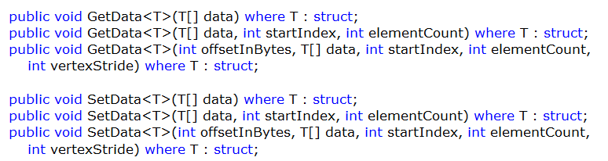
VertexBuffer SetData and GetData
We have used set data
Used to set vertex data that is to be streamed to the GraphicsDevice
Get data copies the data contained in the vertex buffer to an array
Can choose where and how many elements we want
Will return the needed type
Four use this will be the Vector3 positions of each vertex

Slide 9
Vertex Stride
Distance from the beginning of one entity to the beginning of the next entity
Stride is the size in bytes for the data of one vertex
Byte offset from consecutive vertices
In order to access each piece of vertex data we must know the stride to be able to iterate over the byte data

Slide 10
Bounding Volumes

Slide 11
Bounding Box
A box shaped bounding volume that can be used for basic collision detection
Uses min and max vectors to define it’s size
Manually defined
Extracted from model
Axis Aligned Bounding Box
Needs to be continually updated it the object is dynamic

Slide 12
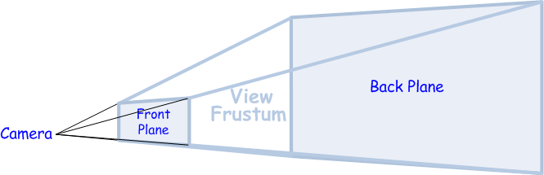
Bounding Frustum
Defines the shape of our View * Projection
Rectangular Pyramid
Typically only used with cameras
Will feature later in the semester for the removal of objects that cannot be seen
Object culling

Slide 13
Bounding Sphere
Axis Aligned Bounding Sphere
A bounding volume in the shape of a sphere
Requires a Position and Radius
Can be used when making more complex objects that require more complex shapes

Slide 14
Extracting Vertices from a Mesh
We need the mesh and the transform associated with it
We check if the mesh has any transforms
Loop through each MeshPart
Use VertexBuffer.GetData to extract the Vector3 data
Transform the Vector3s suing the transform from (Step 2).
Add to a list of Vector3
Repeat for each mesh part (Step 3)
Return the collection of transformed vertices
Create bounding volume
Use for debugging
Use for collision systems

Slide 15
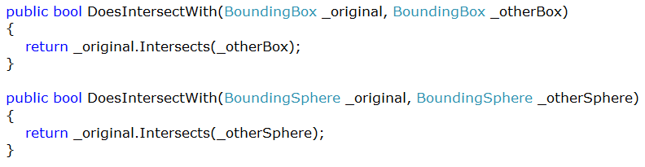
Intersection Checks
We can easily check if two bounding volumes intersect
Intersects(volume) returns a Boolean
Typically we want to compare
Box to Box
Sphere to Sphere

Slide 16
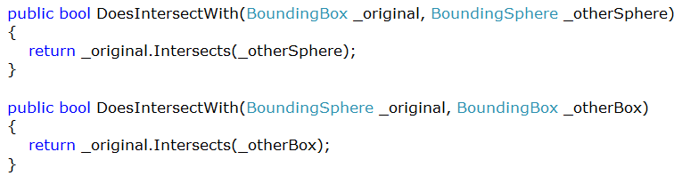
Intersection Checks
Of course will have a mixture of volumes in the game
And we can check intersections the exact same as before
Box to Sphere
Sphere to Box

Slide 17
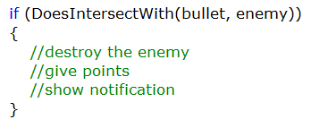
Intersection Example
Note that you would not use a check like this for bullets in a game!
If we used the previous methods to check intersections then we could easily make decision in game objects
What type of object intersected and what is the response to that
Later we will use a physics engine so building this kind of cod into your games will require a re-write later

Slide 18
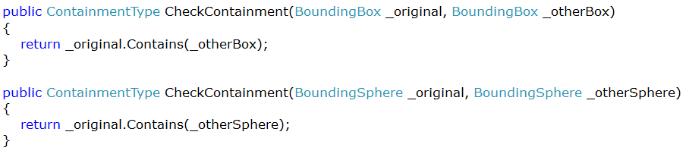
Containment Checks
We can determine the containment state of two volumes
This is used to determine if an object is within another
It tells use the type of containment
Disjoint (None)
Intersects (Partial Containment)
Contains (Fully Contains)

Slide 19
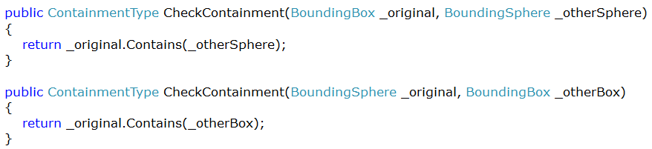
Containment Checks
Just like the intersections we can check
Box to Box
Sphere to Spere
Ray to Box
Ray to Sphere

Slide 20
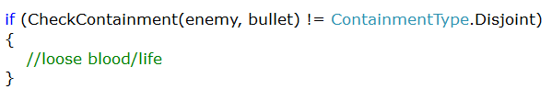
Containment Sample
Again not good for bullets!
If the containment type is anything other than disjoint (none) then take some life of the game object
This can be used with the Camera Frustum to check what game objects are visible
Contained in the view frustum
Object culling

Slide 21
Ray
The Ray in XNA has a
Vector3 Position
Vector3 Direction
Previously mentioned ray casting is frequently found in games
Ray Picking
Keeping object off the ground
Graphics
Casting a ray from the centre of a screen (crosshair) is a typically usage scenario

Slide 22
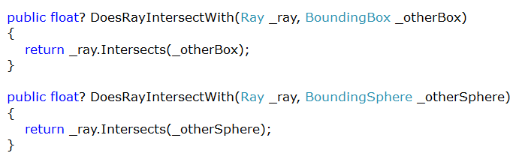
Ray Intersection
Unlike the previous Intersections which returned a bool
Ray returns a nullable float (float?)
If the result is null then no intersection took place
If the result has a value then there was an intersection
And the result is the distance from the source of ray to the intersection
Really goo 3D picking

Slide 23
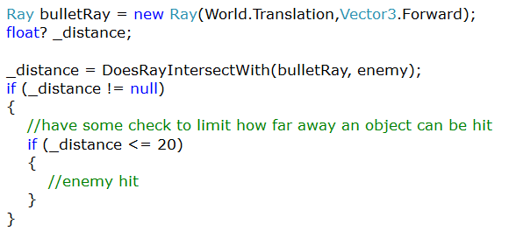
Ray Intersection Sample
Perfect form of collision detection for a bullet
An infinite line from a source in a direction
We do the intersection
Check if not null
Check if within a limit of 20 units
If it is then do something to the enemy

